Slide 1
Refactoring Legacy Code
Lookup Module

Slide 2

Why Refactoring Legacy Code?
Remove the Fear to Change

Slide 3
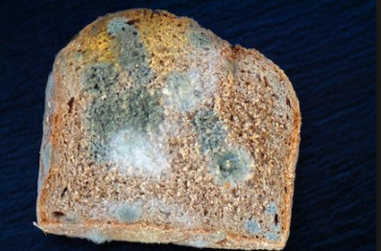
Why Refactoring Legacy Code?
Prevention of Rotting of code

Slide 4
What are Step For Refactoring Code?
Know Before you Go
Mark the code which you refractor .
How it will be refactored?
Image here.

Slide 5
What are Step For Refactoring Code?
Choose The Right Path
This what you are going to do Unit test
Integration Test , Which tool will be use
Junit , Mockito , Stubs , fake etc
Once path defined move on that

Slide 6
What are Step For Refactoring Code?
Trash Your Trash
Define a Rule what is Trash
Make Sure Clean the code removing
Comment , Unused Logic etc
Image here.

Slide 7
What are Step For Refactoring Code?
Be careful with fire
Be carful with the bugs which get introduced while refactoring.

Slide 8

What are Step For Refactoring Code?
Respect wild life
Respect the peer-review comments.
Respect the coding Standard .
Respect the coding Standard .
Effective Java: Edition 3
The book Teaches very well how to Respect wild life java world

Slide 9

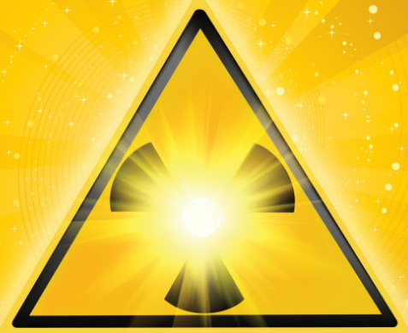
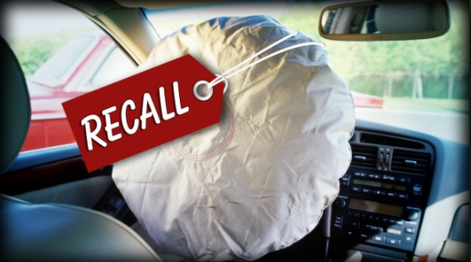
Why TDD Refactoring is need for All code Case Study?
Two important Thing SE handle
Some once Money
Some Once Life

Slide 10
Why TDD Refactoring is need for All code Case Study?
Some Once Life
One of the biggest American market makers for stocks struggled to stay afloat after a software bug triggered a $440 million loss in just 30 minutes. The firm’s shares lost 75 percent in two days after the faulty software flooded the market with unintended trades. One of Knight’s trading algorithms reportedly started pushing erratic trades through on nearly 150 different stocks, sending them into spasms
Source :- https://www.bloomberg.com/news/articles/2012-08-02/knight-shows-how-to-lose-440-million-in-30-minutes

Slide 11
Why TDD Refactoring is need for All code Case Study?
Some once Life
Nissan recalled nearly a million vehicles, including 544,000 Altima sedans, as the front passenger-side airbag might not deploy in a crash.
A system was not able to determine. Whether the front passenger seat is occupied and turn off the airbag if it is vacant or if a small child is seated there. Next to this problem was mostly on vehicles in the 2013-14 model years.
The automakers knew about three mischances in which the traveler had been doing not send in a crash despite the fact that the seat was said to be possessed.
Source :- https://www.caranddriver.com/news/massive-takata-airbag-recall-everything-you-need-to-know-including-full-list-of-affected-vehicles

Slide 12
Why TDD Refactoring is need for All code Case Study?
Some once Life
It is one of the 6 Famous Software Disasters. In which Therapy planning software in a series of accidents, created by Multi data Systems International, a U.S. firm, not able to calculate properly the exact dosage of radiation for patients undergoing radiation therapy. For this reason, multi Data’s software allows a radiation therapist to draw on a computer screen. The placement of metal blocks designed to protect healthy tissue from the radiation.The software will only allow technicians to use four shielding blocks, but the Panamanian doctors wish to use five
Source :- https://www.ncbi.nlm.nih.gov/pubmed/17199912

Slide 13
Symptoms which demanded Refactoring in Lookup
Monolithic code more 100’s of line code
Image
Source :- Code

Slide 14
Symptoms which demanded Refactoring in Lookup
Monolithic Test cases more 100’s of line code
Image
Source :- Code

Slide 15
Start Diagnoses for Code
Monolithic Codecases more 100’s of line code
Image
Source :- Code

Slide 16
Start Diagnoses for Test Code
Monolithic Test more 100’s of line code
Image
Source :- Code

Slide 17
Anti pattern Observed in code
Monolithic Test more 100’s of line code
Image
Source :- Code

Slide 18
Need of The Day Continuous Refactoring
Monolithic Test more 100’s of line code
Image
Source :- Code

